Slide 1
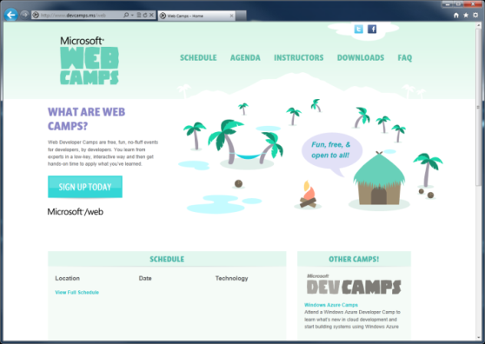

WebCamps Online
Twitter: Follow @webcamps Hashtag #webcamps
SPEAKER NAME/HANDLE HERE
Website: http://www.devcamps.ms/web
What are web camps?
Web Developer Camps are free, fun, no-fluff events for developers, by developers. You learn from experts in a low-key, interactive way and then get hands-on time to apply what you’ve learned.

Slide 2
Top 10 Things You Didn’t Know about WebMatrix 2
Name
Title
Microsoft Corporation

Slide 3
Agenda
Getting Started
Razor

Slide 4

WebCamps Online
Twitter: Follow @webcamps Hashtag #webcamps
INPUT SPEAKER NAME/HANDLE HERE
Website: http://www.devcamps.ms/web
What are web camps?
Web Developer Camps are free, fun, no-fluff events for developers, by developers. You learn from experts in a low-key, interactive way and then get hands-on time to apply what you’ve learned.

Slide 5
Getting Started

Slide 6

WebMatrix Gives You Options
1
Start with a template
Pull in an existing app and start customizing
Open an existing site (even remotely)

Slide 7
Code Completion
2
Text Editing Improvements
WebMatrix adds code completion features for HTML 5, CSS 3, Razor syntax…
PHP and Node.js, too!

Slide 8
What About Data?
3
WebMatrix Database Editing
You can edit the schema of a site’s database or the data itself from within the IDE

Slide 9
Creating New Sites
demo
Using WebMatrix Templates

Slide 10
Razor

Slide 11
Introducing Razor
The easiest way to code websites
Easy to mix HTML and Code
Lots of useful Helpers
010101000101001010010101000100101000100010001000100010110101001010100101
Notes:
1 minute
When you create a new website from scratch in WebMatrix, you will be using the new Razor syntax.
It’s very compact and easy to read and write, and allows you to flow between code and markup seamlessly. You can write your code in languages such as C# or VB, and it’s extensible via Helpers (we’ll talk about Helpers in Part 3)

Slide 12
Razor is a Cut Above the Rest
Web Forms (6 markup transitions)
<ul>
<% for (int i = 0; i < 10; i++) { %>
<li><% =i %></li>
<% } %>
</ul>
PHP (2 markup transitions & an echo)
<ul>
<?php
for ($i = 0; $i < 10; $i++) {
echo("<li>$i</li>");
}
?>
</ul>
Razor (2 markup transitions)
<ul>
@for (int i = 0; i < 10; i++) {
<li>@i</li>
}
</ul>
Notes:
2 minutes
We’ve designed Razor to be concise and easy to use. When we think about the way developers use a language we take into account the context switching they have to do and also the number of keystrokes. The way that Razor allows you to transition seamlessly between markup and code makes for a much more natural and fluent style and also helps to reduce the number of keystrokes and context switching that a developer has to do, thinking about markup and code separately. With Razor, markup and code are really the same thing.
We think it’s the easiest way to code websites and when you compare it to the other languages out there, it’s easy to see why.

Slide 13
Move From Code to Markup Easily with Razor
Option 1:
HTML Block
@{
var name = “John Doe”;
<div>
Your name: @name
</div>
}
Option 2:
Text Block
@{
var name = “John Doe”;
<text>
Your name: @name
</text>
}
Option 3:
Single line of output in markup
@{
var name = “John Doe”;
@: Your name: @name
}
Notes:
1 minute
The transition from code to markup is one of the most elegant things about Razor but there a few rules that are worth knowing about.
Option 1:
Code is the primary citizen in a code block, not HTML. This means the parser will always expect code unless it finds valid opening (and closing) tags. In the first option block you see that after the @{ a name variable is defined. No additional tag is necessary.
A <div> section tells Razor that what follows should be taken as literal. Then the @name indicates a variable that needs to be replaced with its value.
Option 2:
Similarly, to explicitly call out text in a code block as HTML, wrap it in a <text> tag
Option 3:
Single line of output within markup can be denoted by @:
This option is useful when you don’t want to render an HTML element as part of the output.
Extra Knowledge (Advanced):
The Parser that understands Razor is itself a standalone assembly (System.Web.Razor.dll) which has no dependencies on ASP.NET which means you can use it to parse CSHTML/VBHTML files and produce C#/VB code in any .NET application.

Slide 14
Commenting in Razor
Option 1:
Markup
@*
<div>
Hello World
</div>
*@
Option 2:
Code
@{
//var name = "John Doe”;
//@name
}
Option 3:
Both
@*
@{
var name = "John Doe";
@name
}
*@
Notes:
1 minute
It’s always good practice to comment your code. In Razor we have the following options for commenting:
Option 1:
You can comment a block by using @* … *@
Please note that this method could not be recursive (you could not have a @* inside another @*)
Option 2:
You can comment lines by using // (in C#) the same way you do in your code files.
Option 3:
If you need to comment a whole razor block, you should add a @* before the beginning of the code block and a *@ after it’s finish.

Slide 15
Razor Syntax
demo
Notes:
5 minutes
Syntax moving from code to markup
ObjectInfo()
ServerInfo()

Slide 16
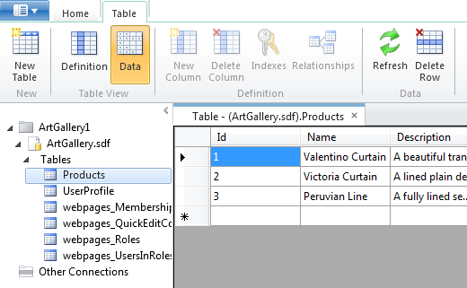
Database
SQL Compact Edition
File-based, so it’s portable. Runs without a server.
Easy to design, easy to code against
@{
var db = Database.Open("ArtGallery");
var product = db.Query("SELECT * FROM PRODUCTS);
}
Designing
Coding
Notes:
2 minutes
The database that comes with WebMatrix is SQL Compact Edition, or SQL CE for short.
It’s free, lightweight and doesn’t require a separate server to run – which makes it much easier to get setup and running than traditional versions of SQL Server like SQL Server Express.
SQL Compact Edition includes tools to manage your tables and data and because it’s file-based, you simply need to copy the database files to transport your database to another machine. This is really useful if you are sharing a database with another developer.
This sample code shows how to connect to an ArtGallery Database and then perform a query with SQL to retrieve the ArtGallery products.

Slide 17
Database Access
demo
Notes:
5 minutes
Creating DB
Designing DB
Accessing DB using Razor
(introduce URLData)

Slide 18
Display Your Data Easily with WebGrid
Displays your data quickly and easily
Lots of options to customize layout, appearance, paging etc.
@{
var db = Database.Open("ArtGallery");
var data = db.Query("SELECT * FROM PRODUCTS);
var grid = new WebGrid(data);
}
<div id="grid">
@grid.GetHtml();
</div>
<div id="grid">
@grid.GetHtml(
columns: grid.Columns(
grid.Column("Name", "Product", style: "product"),
grid.Column("Description", format:@<i>@item.Description</i>),
grid.Column("Price", format:@<text>$@item.Price</text>)
)
)
</div>
@{
var db = Database.Open("ArtGallery");
var data = db.Query("SELECT * FROM PRODUCTS);
var grid = new WebGrid(
source: data,
defaultSort: "Name",
rowsPerPage: 3);
}
4
Notes:
2 minutes
As we’ve seen, the database design and access from Razor code in WebMatrix is easy. Often when we’re building websites, we’ll want to render data in some form of table. The WebGrid can help to make this easy to do.
Build 1
In it’s simplest form, just give the WebGrid data and it will render it out in a valid HTML table. WebMatrix will make all the magic for you. But this has a few drawbacks: You’re not choosing the columns you want to show and they will be named as the field names in the database.
Build 2
In the second sample, you explicitly state which columns to include in the WebGrid, their title (e.g.: «Product» instead of «Name») and how they will be formatted: Product column will use a CSS style, Description will appear in italic font, and so on.
Build 3
In the last sample, you can see that we order the data by the «Name» column and by simply defining one parameter, we state that we want 3 rows per page. WebMatrix will do the rest for you.

Slide 19
Razor tools for a Consistent Look
Layouts
Consistent structure, organization (Includes ⇨ Master Pages ⇨ Layouts)
Sections
Named regions of dynamic code
<div id="grid">
@grid.GetHtml(
columns: grid.Columns(
grid.Column("Name", "Product", style: "product"),
grid.Column("Description", format:@<i>@item.Description</i>),
grid.Column("Price", format:@<text>$@item.Price</text>)
)
)
</div>
Themes
Site-wide, runtime reskinning that’s CSS friendly
@{
var db = Database.Open("ArtGallery");
var data = db.Query("SELECT * FROM PRODUCTS);
var grid = new WebGrid(
source: data,
defaultSort: "Name",
rowsPerPage: 3);
}
5
Notes:
1 minute
Razor has some great tools to help you organize your markup, keep things consistent, and eliminate repetition.

Slide 20
Layouts Make Organizing Your Pages Easier
Don’t repeat yourself!
Define one layout and use it across your website
Layout.cshtml
Page 1
Page 2
Page 3
Notes:
1 minute
The bigger your site, the more pages you’ll have. One thing to keep in mind when building websites is how it will be navigated by users. The content usually changes from one page to the other, but the structure of the site, its menu, links, images, remain constant across all pages. As you add new pages and functionality, chances are that you find yourself repeating the same markup (HTML) , copy and pasting code across multiple pages to keep this consistency, and having to make changes everywhere every time you want to change the appearance of the website, etc.
Here is were layouts come to the rescue!
Layout pages allow you to organize commonly used markup and code into one file and then reuse it across multiple pages on your website. They are pages that contain HTML-formatted content that can be shared by pages on the website. A layout page defines the structure of the web page, but doesn't include any actual content. After you've created a layout page, you can create web pages with content and then link them to the layout page. When these pages are displayed, they will be formatted according to the layout page.

Slide 21
Layout Syntax
Define your Layout
Reference it in your pages
/Shared/_Layout.cshtml
MyPage.cshtml
<html>
<head>
<title>Simple Layout</title>
</head>
<body>
@RenderBody()
</body>
</html>
@{
Layout = "/Shared/_Layout.cshtml";
}
<p>
My content goes here
</p>
Notes:
1 minute
In order to use Layout pages you have to:
Define the layout page
Reference it in your pages.
1. In this sample, we define an html section containing a header, a title and then a block for the body: @RenderBody()
2.Then in MyPage we reference the layout page and then add a content in a <p> paragraph.
This results in a page that contains the structure of _Layout and the content defined in MyPage.
This will allow you to have all the common content and graphic layout in the _Layout page, and when needed, making layout changes in one place only..

Slide 22
Use Sections to Organize Your Pages
Sections allow you to define areas of content that change between pages but need to be included in a layout
/Shared/_Layout.cshtml
MyPage.cshtml
<html>
<head>
<title>Simple Layout</title>
</head>
<body>
@RenderSection("Menu")
@RenderBody()
</body>
</html>
@{
Layout = "/Shared/_Layout.cshtml";
}
@section Menu {
<ul id="pageMenu">
<li>Option 1</li>
<li>Option 2</li>
</ul>
}
<p>
My content goes here
</p>
Notes:
1 minute
Think of RenderBody as rendering an unnamed or default section in your page. We can also add named sections too for content which we often expect to see in our pages. A good example is a header or a menu which might change based on the visited page. All the logic to create this menu depending on who is logged on, and how to create it, (e.g: using graphic files and hyperlinks) could be in a separated file.
Normally, the sections that you create in a content page have to match the sections that are defined in the layout page. You can override this behavior for a named section by declaring the section to be optional in the layout page. This lets you define multiple content pages that can be shared. To do this, in the layout file change the render of a section adding a “required: false” parameter
@RenderSection("header", required: false)
@* Background Info *@
http://www.asp.net/webmatrix/tutorials/3-creating-a-consistent-look

Slide 23
Use RenderPage to Organize Pages That Don’t Change
RenderPage() helps you reuse markup and code that doesn’t change
/Shared/_Layout.cshtml
/Shared/_Footer.cshtml
<html>
<head>
<title>Simple Layout</title>
</head>
<body>
@RenderSection("Menu")
@RenderBody()
@RenderPage("/Shared/_Footer.cshtml")
</body>
</html>
<div class="footer">
© 2010 Contoso
</div>
Notes:
30 seconds
Sometimes you find content and code that doesn’t change, for instance: header and footer. They remain the same across all your site. To do this, you can use the @RenderPage command.

Slide 24
Layouts
demo
Notes:
5 minutes
See demo script for flow

Slide 25
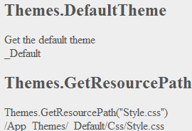
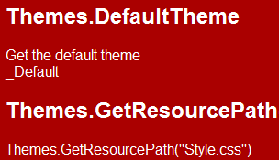
What Are Themes?
Themes allow you to use different designs for your website
Your users can switch between themes
Notes:
1 minute
Suppose that you want to change your site style for Christmas. To do this, you have to replace all your colors, buttons, background images and icons. To simplify this, you could use themes and change it in a blink.
In this sample, you could see how the background, font family and color were changed. You can change this in your sites or even let your user to pick a theme for him.

Slide 26
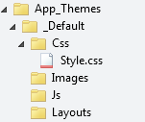
Using Themes
Arrange your themes in App_Themes Folder
Register the theme in your app_start
If WebMatrix doesn’t find the resources for a theme, it uses the default resource
@{
Themes.Initialize("~/App_Themes","_Default");
}
Notes:
1 minute
In order to use Themes you have to:
Create an “App_Themes“ folder at the root of your site
Place all your Style sheet files (CSS), images, Javascript and Layout files.
Register the theme in your app_start
Themes work in a hierarchical way, if they don’t find a specific resource (e.g.: image file) it will use the one defined in the default theme.

Slide 27
Using Themes with Stylesheets
Themes can override and inherit from a base stylesheet so you don’t repeat yourself
/template/base.css
/template/foo.css?
body
{
background-color:#EEEEEE;
color:#555555;
}
body
{
background-color:#0000AA;
font-family:"Courier New";
}
Notes:
1 minute
Because of its hierarchical structure, in a specific style file you can redefine only the styles you want to override.
For instance, in base.css you can define the background and font color for body objects. In foo.css you only override the font color; the background will stay the same as base.css. Additionally, you can modify the font to use “Courier New”.

Slide 28
Themes
demo
Notes:
5 minutes
See demo script for details

Slide 29
What Are Helpers?
Helpers make it easy to quickly add commonly used functionality into your websites
Helpers are designed to make your life easier
Some examples:
Facebook
Twitter
PayPal
UserVoice
OData
Windows Azure Storage
And many more…
6
Notes:
2 minutes
WebMatrix Helpers help you add common functionality to your Web site. They can be used to solve a specific web site tasks. You can think of them as bricks that are used/reused and interconnected to build a site. Nothing stops you from creating a helper and reusing it on different pages of your site, or even in different sites. And you can use helpers created by others. Here is a sample of existing

Slide 30
Helpers Fit Into Two Categories
You can think of Helpers like this:
HTML Helpers
Make is faster and easier to render commonly used markup to the page.
Examples: Facebook, Twitter
API Helpers
Make is faster and easier to call complex APIs from your website.
Examples: PayPal, OData, Windows Azure Storage
Notes:
1 minute
HTML Helpers focus in look & feel and simple connection with other sites, like Facebook and Twitter.
API Helpers are more complex helpers, conceived to interact with external services. Their focus is not based on the user interface, but the service integrity, for instance how to secure a transaction in PayPal or registering an order to update your storage in a Windows Azure Account.

Slide 31
Adding Helpers to Your Website
There are two ways to install Helpers in your website
1
2
Package Manager
Manual download
Notes:
1 minute
Although these three ways to install Helpers are simple and straightforward, we’ll focus on the first one: using the Package Manager, but you could manually download and copy a Helper to your site folder. Either will work for you.

Slide 32

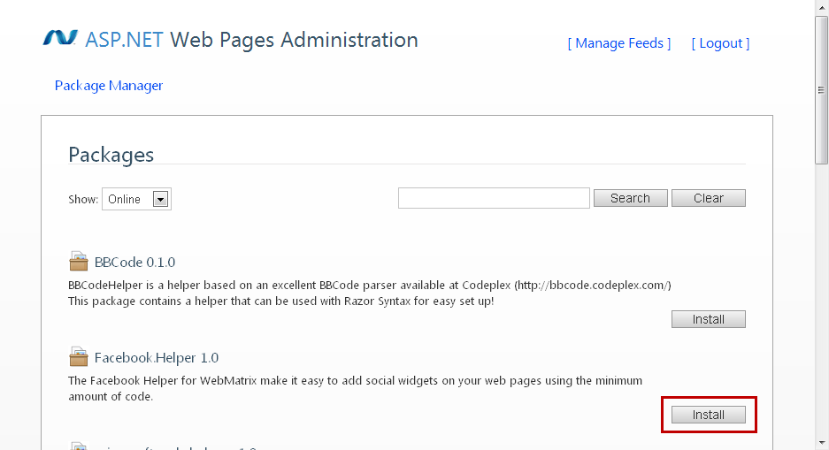
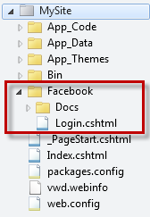
Installing Helpers Using Package Manager
Create a blank website in WebMatrix
Run your website and visit _admin
Select and install Helpers
/_admin
Facebook Helper installed
7
Notes:
1 minute
To install Helpers using the Package Manager, you have to browse _admin page of your site. If it’s the first time, you’ll be prompted to enter a new password, that will be used for further visits.
After that, a page will display a list of Helpers, indicating which are already installed and which could be installed.
We will show you this process in a demonstration shortly…

Slide 33

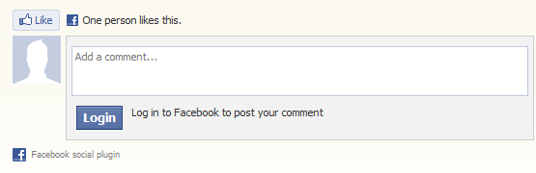




Make Your Website Social
8
Add social capabilities to your website with the WebMatrix Helper for Facebook
There are many more helpers available for WebMatrix
@FacebookSocialPlugins.Comments()
Notes:
1 minute
If people like something on your site, they often want to share it with friends. For instance, to comment on Facebook, you can download the FacebookSocialHelper and then add the @FacebookSocialPlugins.Comments() in your page to show the Facebook comments’ controls.
Microsoft has also been working on a large number of helpers for WebMatrix including Twitter, PayPal, bit.ly and Uservoice. They are all available using Package Manager and they are designed to be very easy to use.

Slide 34
Helpers
demo
Notes:
5 minutes
For detailed steps please see the demo scripts
// more this to the demo script
New Bakery (existing bakery from prev demo?)
Install Twitter to the homepage
Add Twitter to the homepage
Install Facebook Social Plugin
Show how we have other helpers like PayPal

Slide 35
What is Membership?
9
Provides registration for users
Organize users into roles
Restrict access to pages on your website based on user or role
WebMatrix includes helpers & database that makes setting up membership easy
Some templates include Admin folder with all the pages required for membership
Notes:
1 minute
You can set up your website so that users can log into—that will mean that your site should support membership. This can be useful for many reasons. For example, your site might have features that are available only to members. In some cases, you might require users to log in to send you feedback or leave a comment.
Even if your website supports membership, users aren't necessarily required to log in before they use some of the pages on the site. Users who aren't logged in are known as anonymous users.
A user can sign in on your website and can then log in to the site. The website requires a user name (or an email address) and a password to confirm that users are who they claim to be. This process of logging in and confirming a user’s identity is known as authentication.

Slide 36
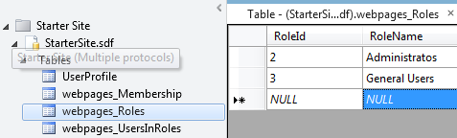
Setting Up Membership
Setup membership in one line of code
/_AppStart.cshtml
@{
WebSecurity.InitializeDatabaseConnection("StarterSite", "UserProfile", "UserId", "Email", true);
}
StarterSite database
Notes:
1 minute
The StarterSite Template comes with membership configured, and with a Database ready to be filled with users as well as their roles in the website.
First, you have to uncomment the WebSecurity.InitializeDatabaseConnection and fill the parameters with a userProfile and userId to be defined in the database.

Slide 37
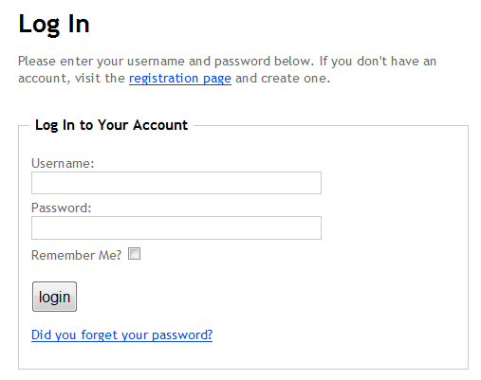
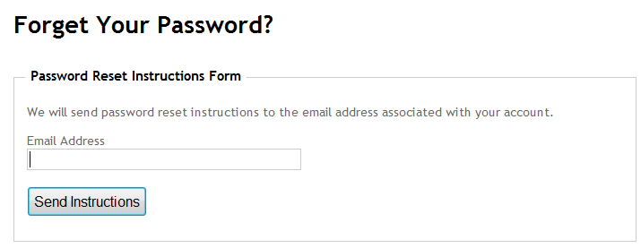
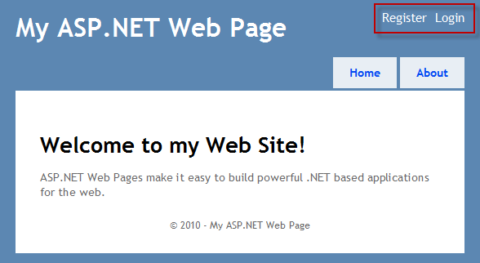
Templates with Membership
Some templates come with an admin folder containing membership pages ready to go
Notes:
1 minute
The StarterSite template and others include pages that handle membership, like register, forgotten password etc. If you are creating a website from scratch, we recommend you still use the admin pages from one of the templates because it’ll get you going much more quickly.

Slide 38
Controlling Access to Pages
You can control access to pages based on the following:
Is the user logged in?
Does the user have access to the page?
Does the user belong to the correct role?
@if (!WebSecurity.IsAuthenticated) {
Response.Redirect("/Account/Login");
}
@if ( Roles.IsUserInRole("admin")) {
<span> Welcome <b>@WebSecurity.CurrentUserName</b>! </span>
}
Notes:
1 minute
By using Membership you can easily verify if the user is authenticated, or if it’s an anonymous user. Also if the user trying to reach a specific page has a role with granted privileges to that page.

Slide 39
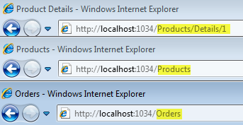
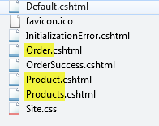
Routing
10
WebMatrix automatically provides “clean” URLs using Routing and removes the need to use QueryStrings
Routing has the following benefits:
Easier to read for your users
Better for SEO
Notes:
2 minutes
Today’s websites often use “clean URLs” that make the current page much more readable for both humans and search engines. With WebMatrix you get the modern, clean urls out of the box because it uses “routing” by default.
Routing maps a URL to a resource on the server using a set of predetermined rules. For instance a url with Order will map to Order.cshtml. If you add a “slash” and a string after the first route segment, like in the “product” example, that string will become part of the “Url Data” which is then accessible in code from within product.cshml.

Slide 40
Why Build Helpers?
11
(Bonus!)
1
2
Helpers make you more productive
Helpers make it easier for other developers to use your widgets or services
Create Helpers for code that is repetitive
Create Helpers for code that is complex
Useful if you are trying to create a developer ecosystem of your own
Notes:
1 minute
There are a couple of reasons why you might want to build your own helpers for WebMatrix.
Firstly, over time you will find that using Helpers will save you time when building websites with WebMatrix. There will also be times when you find yourself doing repetitive and/or complex tasks. This is often a sign that a Helper will help you to save time in future projects with code-reuse.
Secondly, Helpers are useful when trying to create a developer ecosystem around your own product/website/service by making it as simple as possible to get going building a website that uses your stuff.

Slide 41
Build a Helper: The 3 Approaches
Use Inline Code
Use a Class (Intermediate)
Use an assembly (DLL) (Advanced)
@helper syntax using CSHTML
For simple helpers
Static class with Static methods
For helpers that use .NET Framework
Requires Visual Studio 2010 for development
For complex helpers that require testing
Notes:
3 minutes
There are 3 approaches for building WebMatrix Helpers.
Using Inline Code
This is the simplest approach for building helpers.
An Inline Code helper uses Razor, and its cshtml code file is stored inside App_Code.
When should we use it? For simple helpers
Using a Static Class
This approach is an enhancement of Inline codes helpers, that uses Csharp or Vbasic classes.
When should we use it? For more helpers that use .NET Framework
Creating an assembly (DLL)
This is an advanced approach for Visual Studio developers.
When should we use it? For complex helpers that will require more than one code file, and will also require testing.
In the next slides, we will explore the first 2 approaches…

Slide 42
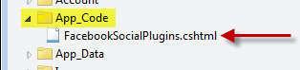
Building Helpers – Inline Syntax
Use CSHTML
Save in App_Code folder
The name of the file is important – it’s used as the class name:
@FacebookSocialPlugins.ShowLoginButton(...);
Notes:
2 minutes
This is the most straightforward way to build helpers.
To create an inline helper, you will have to write a cshtml file with the function needed, and save it inside your App_Code folder. You can also include external helpers, like FacebookSocialPlugins, and reuse your helpers in different projects.
The file name will be used as the class name, and that’s why its name is important!

Slide 43
Building Helpers – Inline Syntax
@helper
Easy to create HTML shortcuts
Wrap commonly used HTML
Takes parameters
Real example: Facebook Social Plugins
@helper HelloWorld(string name = "") {
<div>Hello @name</div>
}
@helper ShowLoginButton(string buttonText = "") {
<fb:login-button>@buttonText</fb:login-button>
}
Notes:
1 minute
If you have an HTML code that is repeated along your site, you can create an inline helper as a shortcut for pasting your code everytime you need it.
The helper can even receive parameters and include HTML functionality based on those parameters.
For example, this HelloWorld helper method displays a name passed as a parameter inside a <div>.
Another helper method could show the Facebook Log In button, changing its text based on the parameter passed.
For a real example of using this approach, download and install the Facebook Helper, you can open the file and inspect the code and understand how to build an official helper.

Slide 44
Building Helpers – Inline Syntax
@function
Return values from your helpers
Good for wrapping complex APIs
See the Twitter Helper for examples
@functions {
public static string SayHello(string name) {
return “Hello ” + name;
}
}
Notes:
2 minutes
If you are familiar with c# and want to take advantage of .NET Framework , you can implement a different approach by defining an inline helper as a static method by using @function.
You will get the same functionality as in the previous approach, but now you will be able to return values from the helper instead of working with HTML code.
For example, this SayHello helper method receives a name as a parameter and returns a «hello, name» inside a string.
Static methods we are using in this approach can also hide complex functions. This action is known as «wrapping».

Slide 45
Building Helpers
demo
Notes:
5 minutes
See demo script for flow

Slide 46
Recap: Top 10 11 Things You Just Learned about WebMatrix 2
WebMatrix gives you options
Code Completion
Data Management
WebGrid
Razor tools for a consistent look
Built-in helpers
Package Manager
Social Site Integration
Easy Membership & Security
Routing
Built your own helpers

Slide 47
Get This Content, and More
www.webcamps.ms
www.asp.net/webmatrix
www.microsoft.com/web/webmatrix

